Slide 1
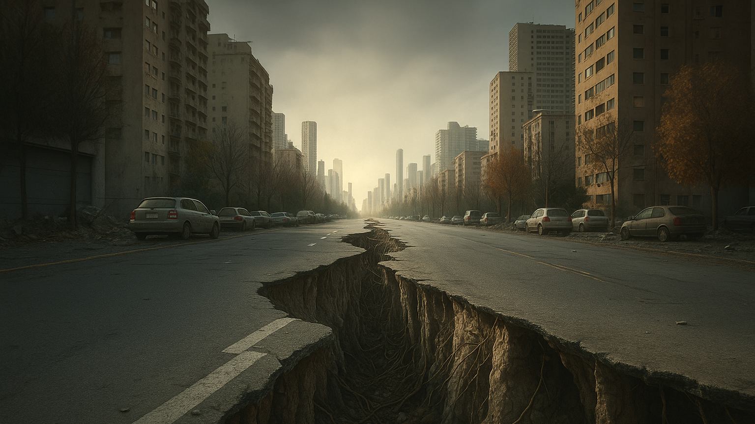







Table of
Contents
Table of
Contents
Tectonix
Exploring
Earth’s Tremors
Team SkyNet :
JAISHNAV DAS
PRATEEK DEBNATH
RAHUL AHMED
BISWARUP GOSWAMI
Notes:
https://www.freepik.com/free-ai-image/photorealistic-timber-house-interior-with-wooden-decor-furnishings_152371631.htm

Slide 2












Table of
Contents
9 September 2025
Presented by: SkyNet
Notes:
https://www.freepik.com/free-ai-image/photorealistic-timber-house-interior-with-wooden-decor-furnishings_152371631.htm

Slide 3

Problem
Here are the problems that users have
87%
93%
97%
of the target audience is experiencing this problem
of the target audience is looking for an alternative
of the target audience reports it as the biggest pain

Slide 4
Problem
The Gap in Earthquake Awareness
🌍 20,000+ earthquakes happen each year, 16 are major.
💔 Recent disasters show huge human & economic losses.
🏫 Learning is theory-heavy → no real-time, interactive tools.
🚨 Leads to low awareness & preparedness among students.
👉 We need an engaging, data-driven way to teach earthquake science

Slide 5
Solution
Your
Solution
Benefit 1
Provide more information about this point. Keep it short and sweet
Benefit 2
Provide a bit more information about your super-duper awesome solution over here. Keep it easy peasy lemon squeezy.
Provide more information about this point. Keep it short and sweet
Benefit 3
Learn More
Provide more information about this point. Keep it short and sweet

Slide 6
Solution
📈 Combines live USGS data with interactive charts & filters.
Your
Solution
🎓 Adds learning overlays (seismic zones, tectonic plates, safety tips).
🌍 Browser-based platform for visualizing real earthquakes on maps.
🧑‍🏫 Transforms earthquake science from static theory → engaging exploration.

Slide 7

Key
Features
The market for our product is large and growing fast.
2024
2025
2026
2027
2028
2029

Slide 8
Key Feature
Making Earthquake Science Engaging
🌍
Interactive Map → visualize hotspots globally
📊
Data Visualization → graphs of magnitude, depth, time.
🔎
Smart Filters → region, timeframe, intensity.
🎓 Educational Overlays → tectonic plates, seismic zones.

Slide 9
Technology
Stack
Overview of our
business model
1
2
3
4
5
Provide more info about this business model stage
Provide more info about this business model stage
Provide more info about this business model stage
Provide more info about this business model stage
Provide more info about this business model stage

Slide 10
Technology Stack
Built with Modern Web Tools
1
2
3
Frontend:
React.js / HTML, CSS, JS
🗺️Maps & Graphs: Leaflet.js / Mapbox + Chart.js / D3.js.
Data Source: USGS Earthquake GeoJSON API.

Slide 11

Demo/
Prototype
Key milestones
LAUNCH
TESTING
DEVELOPMENT
CONCEPT
ANALYSIS
JAN
FEB
MAR
APR
MAY
JUN
JUL
AUG
SEP
OCT
NOV
DEC

Slide 12
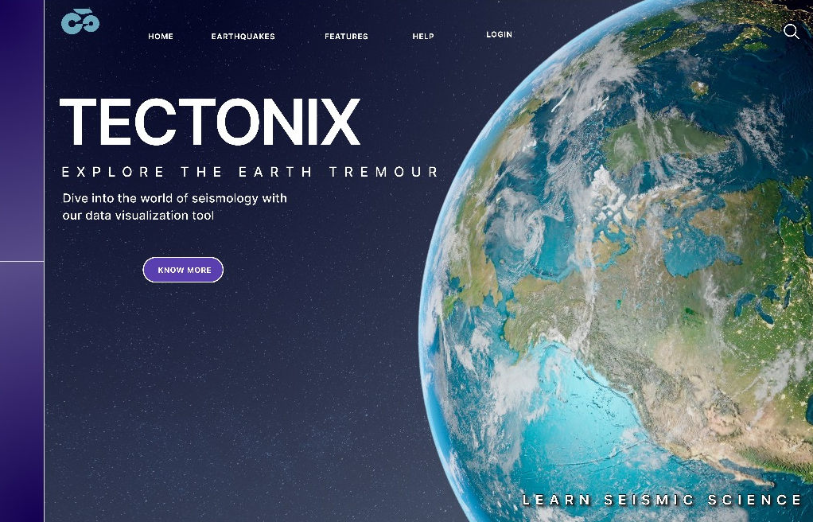
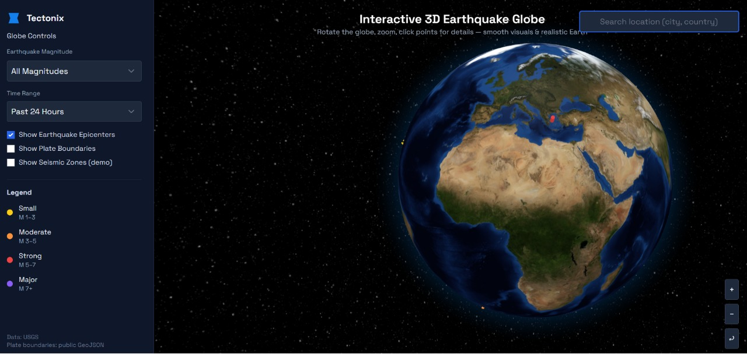
Demo / Prototype

Slide 13
Impact
We're well positioned to win in this market.
Top
LOGO
LOGO
Left
Right
LOGO
LOGO
Bottom

Slide 14
Impact
Why It Matters :
🧑‍🎓 Students get hands-on learning beyond textbooks.
🌐 Promotes awareness & preparedness for disasters.
💡 Can expand to other hazards (volcanoes, tsunamis, floods).
📚 We bridge data science and education in a way that’s fun.

Slide 15
Future
Scope

Slide 16
Future Scope
🌐 3D tectonic animations for deeper understanding.
🕶️ AR/VR integration → immersive earthquake simulations.
🗣️ Local language support → reach rural schools.
📚 Expand into full disaster education suite (volcanoes, tsunamis, floods).

